Slide 1
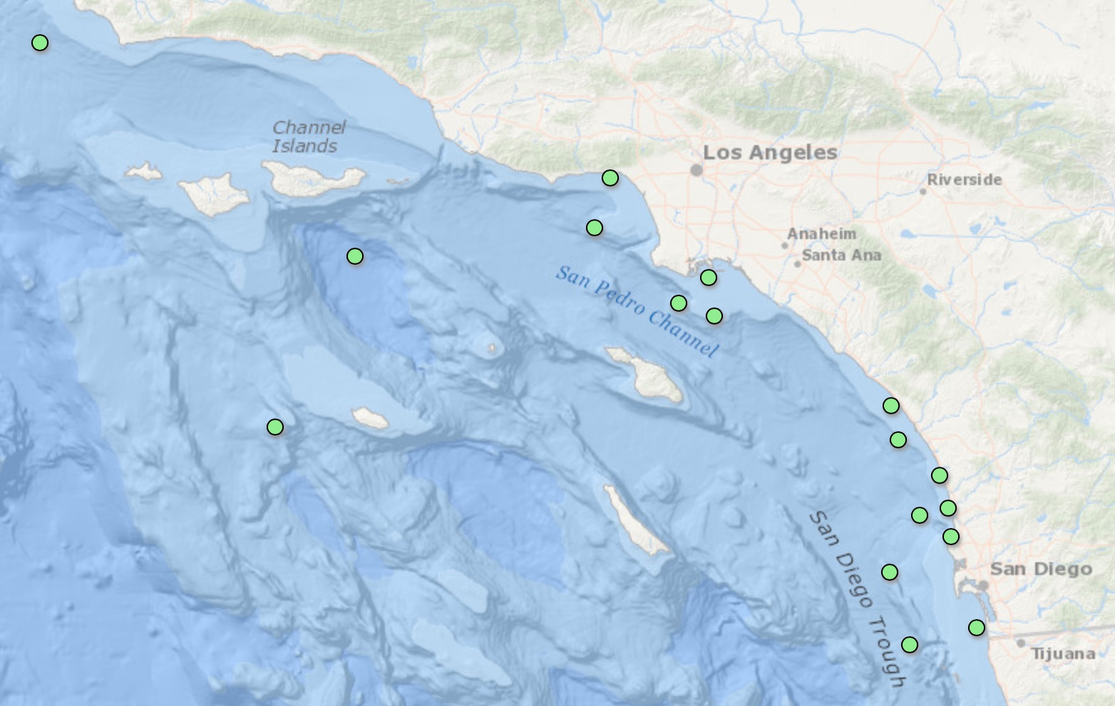
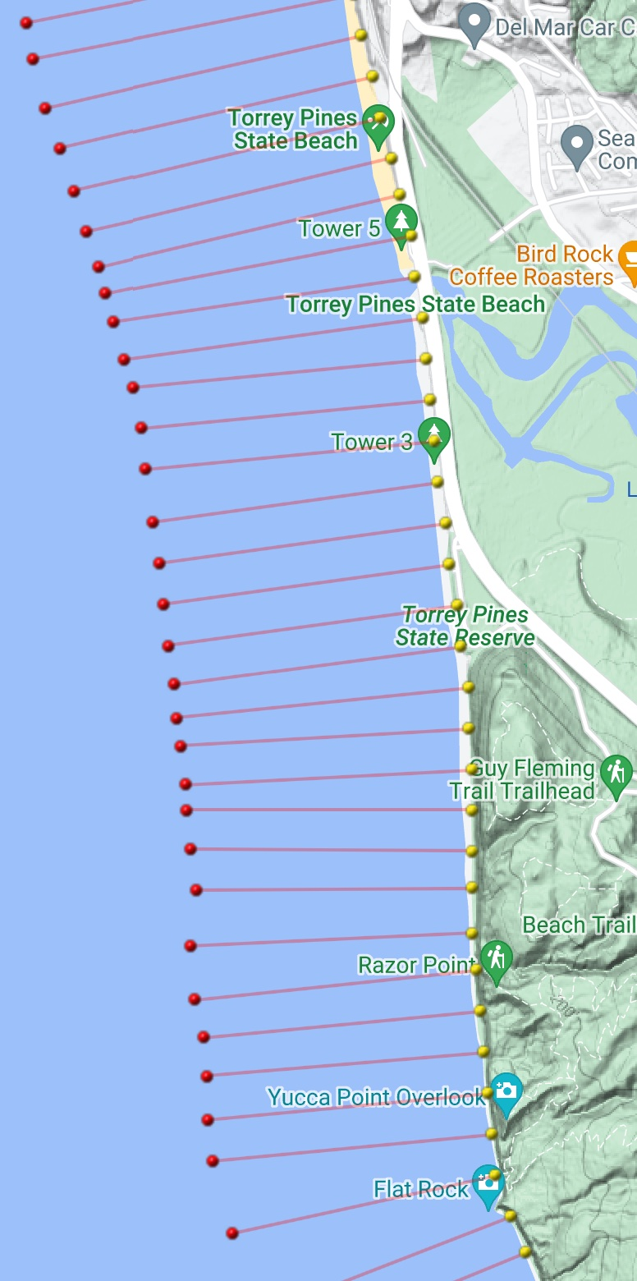
MOP Nearshore Wave and Beach Climatology
SIO Waves and Beaches Monitoring and Prediction (MOP) System
MOP Lines
2000-Present
Scripps Beach
Surveys
2000-Present
Nearshore Wave
Hindcasts
Scripps Wave Buoys
Thanks Ron!
Notes:
1

Slide 2
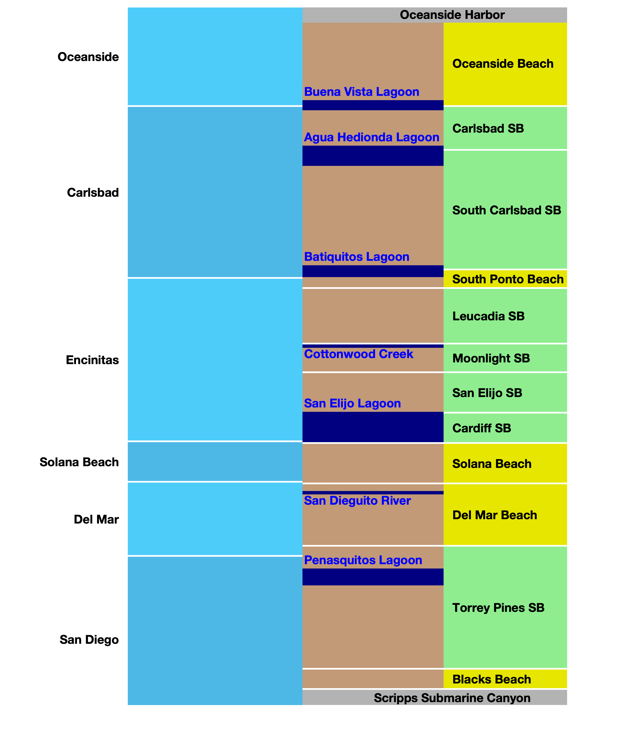

ONGOING RESEARCH:
The NEARSHORE River OF SAND
Traditional Idea
Winter north swells move sand south.
waves
sand
Summer south swells move sand north.
Net annual sand transport is SOUTH.
Net Annual
Transport
Sand is eventually lost down the Scripps Submarine Canyon.
X

Slide 3
ONGOING RESEARCH:
The NEARSHORE River OF SAND
Annual Net
Transport
Reversals
Hypothesis Based on
Nearshore Wave Modeling
During typical non-El Nino Years:
8 Wave-driven Littoral Subcells
Net annual sand transport is NORTH just
south of lagoons, creeks, rivers, and
north of the Scripps Submarine Canyon.
Maximum southward transport rates between
reversal points increase as you go from
Oceanside to Blacks Beach.

Slide 4
ONGOING RESEARCH:
The NEARSHORE River OF SAND
No
El Nino
Hypothesis Based on
Nearshore Wave Modeling
?
During typical non-El Nino Years:
8 Wave-driven Littoral Subcells
Net annual sand transport is NORTH just
south of lagoons, creeks, rivers, and
north of the Scripps Submarine Canyon.
Maximum southward transport rates between
reversal points increase as you go from
Oceanside to Blacks Beach.
Transport reversal areas have bigger waves.
Possible offshore sand loss?
?
?
?
?
?
?
?

Slide 5
ONGOING RESEARCH:
The NEARSHORE River OF SAND
Strong
El Nino
No
El Nino
Hypothesis Based on
Nearshore Wave Modeling
During typical non-El Nino Years:
8 Wave-Driven Littoral Sub-Cells
Net annual sand transport is NORTH just
south of lagoons, creeks, rivers, and
north of the Scripps Submarine Canyon.
During Strong El Nino Years:
Net annual sand transport is SOUTH
EVERYWHERE and more like the
traditional river of sand.
X

Slide 6
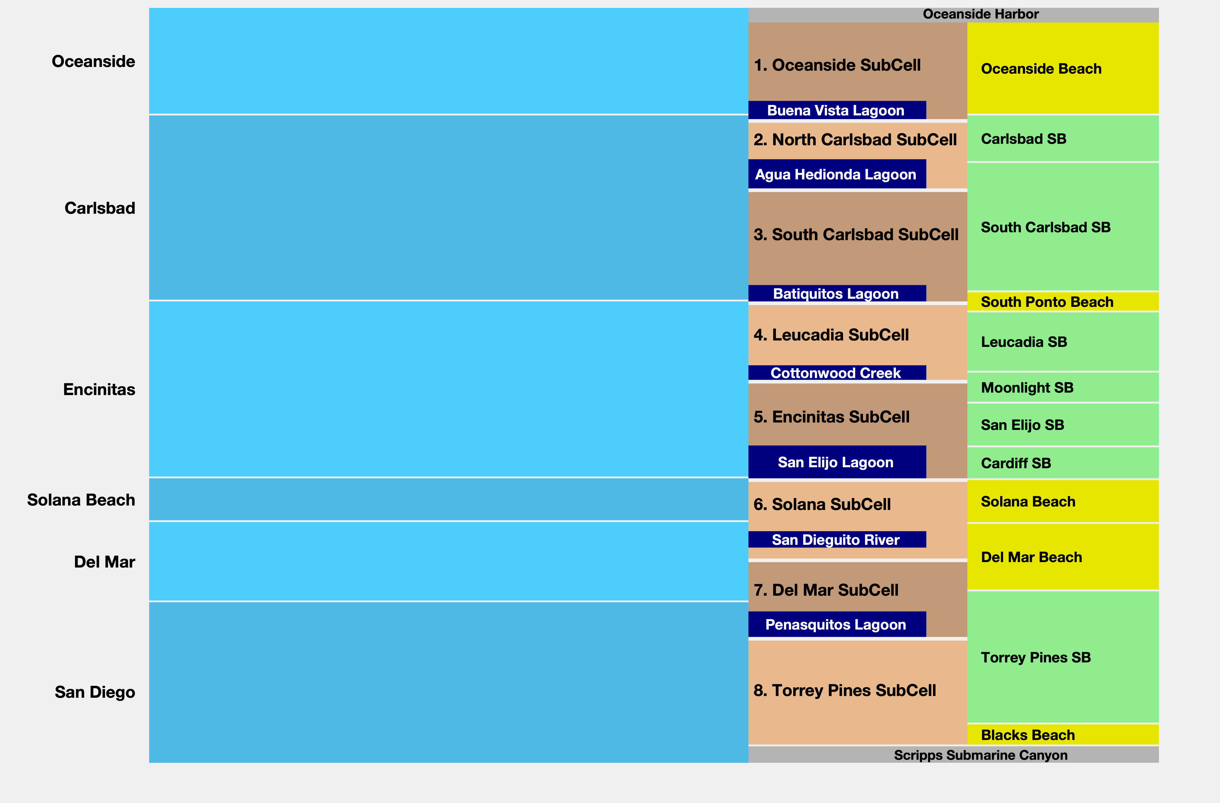
MOP Waves & BEACHES
8 Sub-Cells

Slide 7
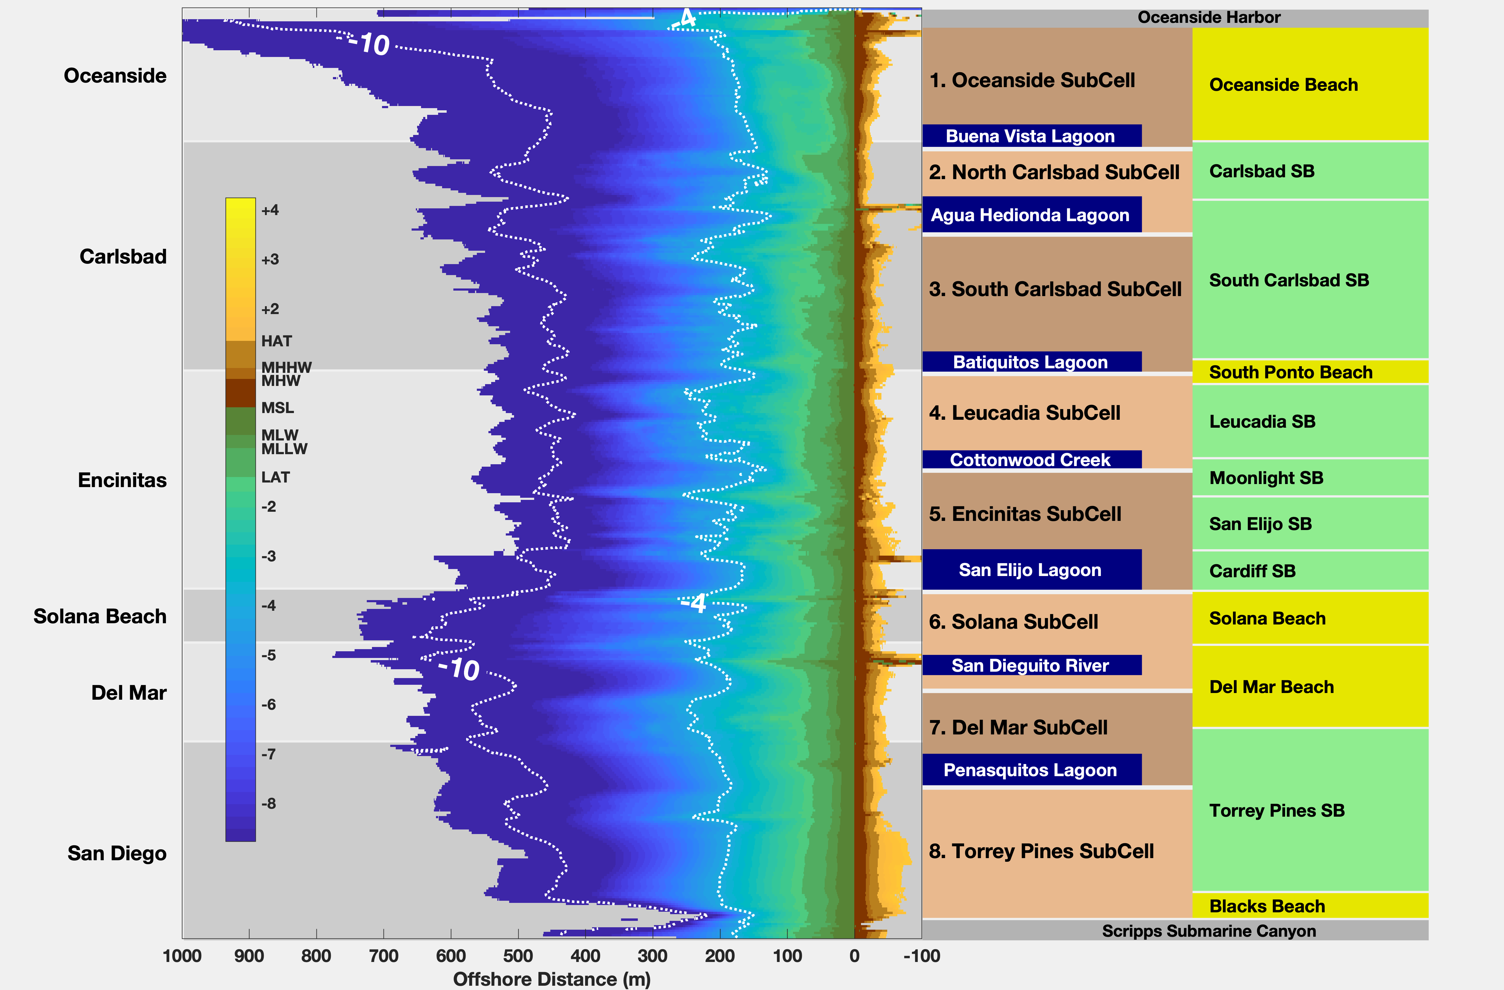
MOP Waves & BEACHES
m
8 Sub-Cells
Mean
Nearshore
Profiles
(m, MSL)
m

Slide 8
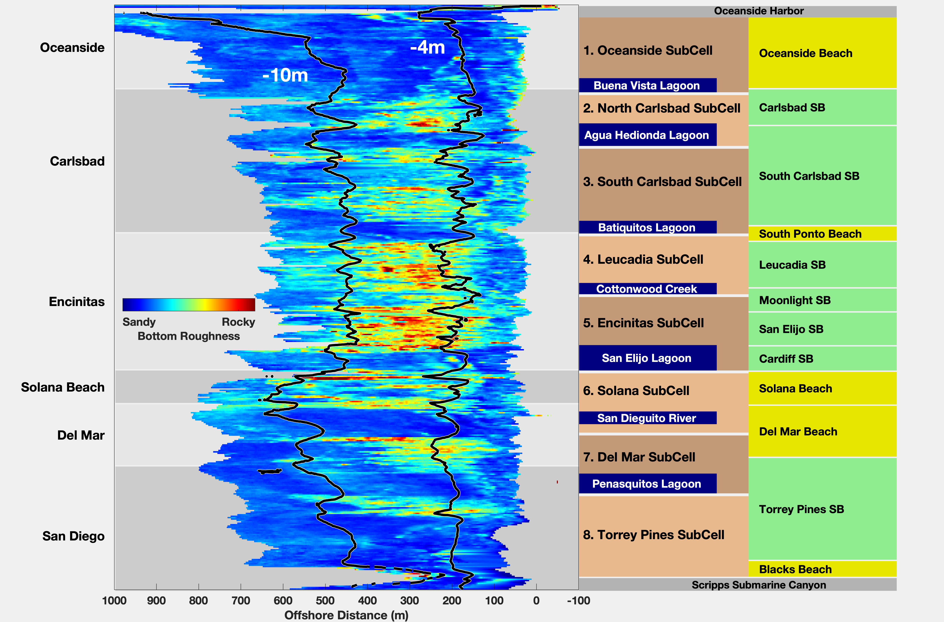
MOP Waves & BEACHES
8 Sub-Cells
Nearshore
Substrate

Slide 9
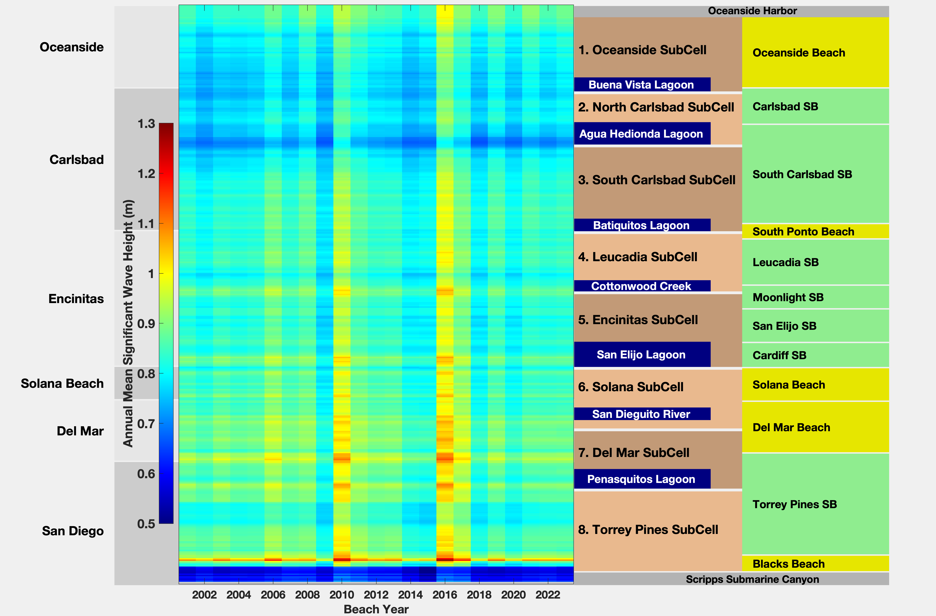
MOP Waves & BEACHES
8 Sub-Cells
Annual Mean
Wave Heights
(10m Depth)

Slide 10
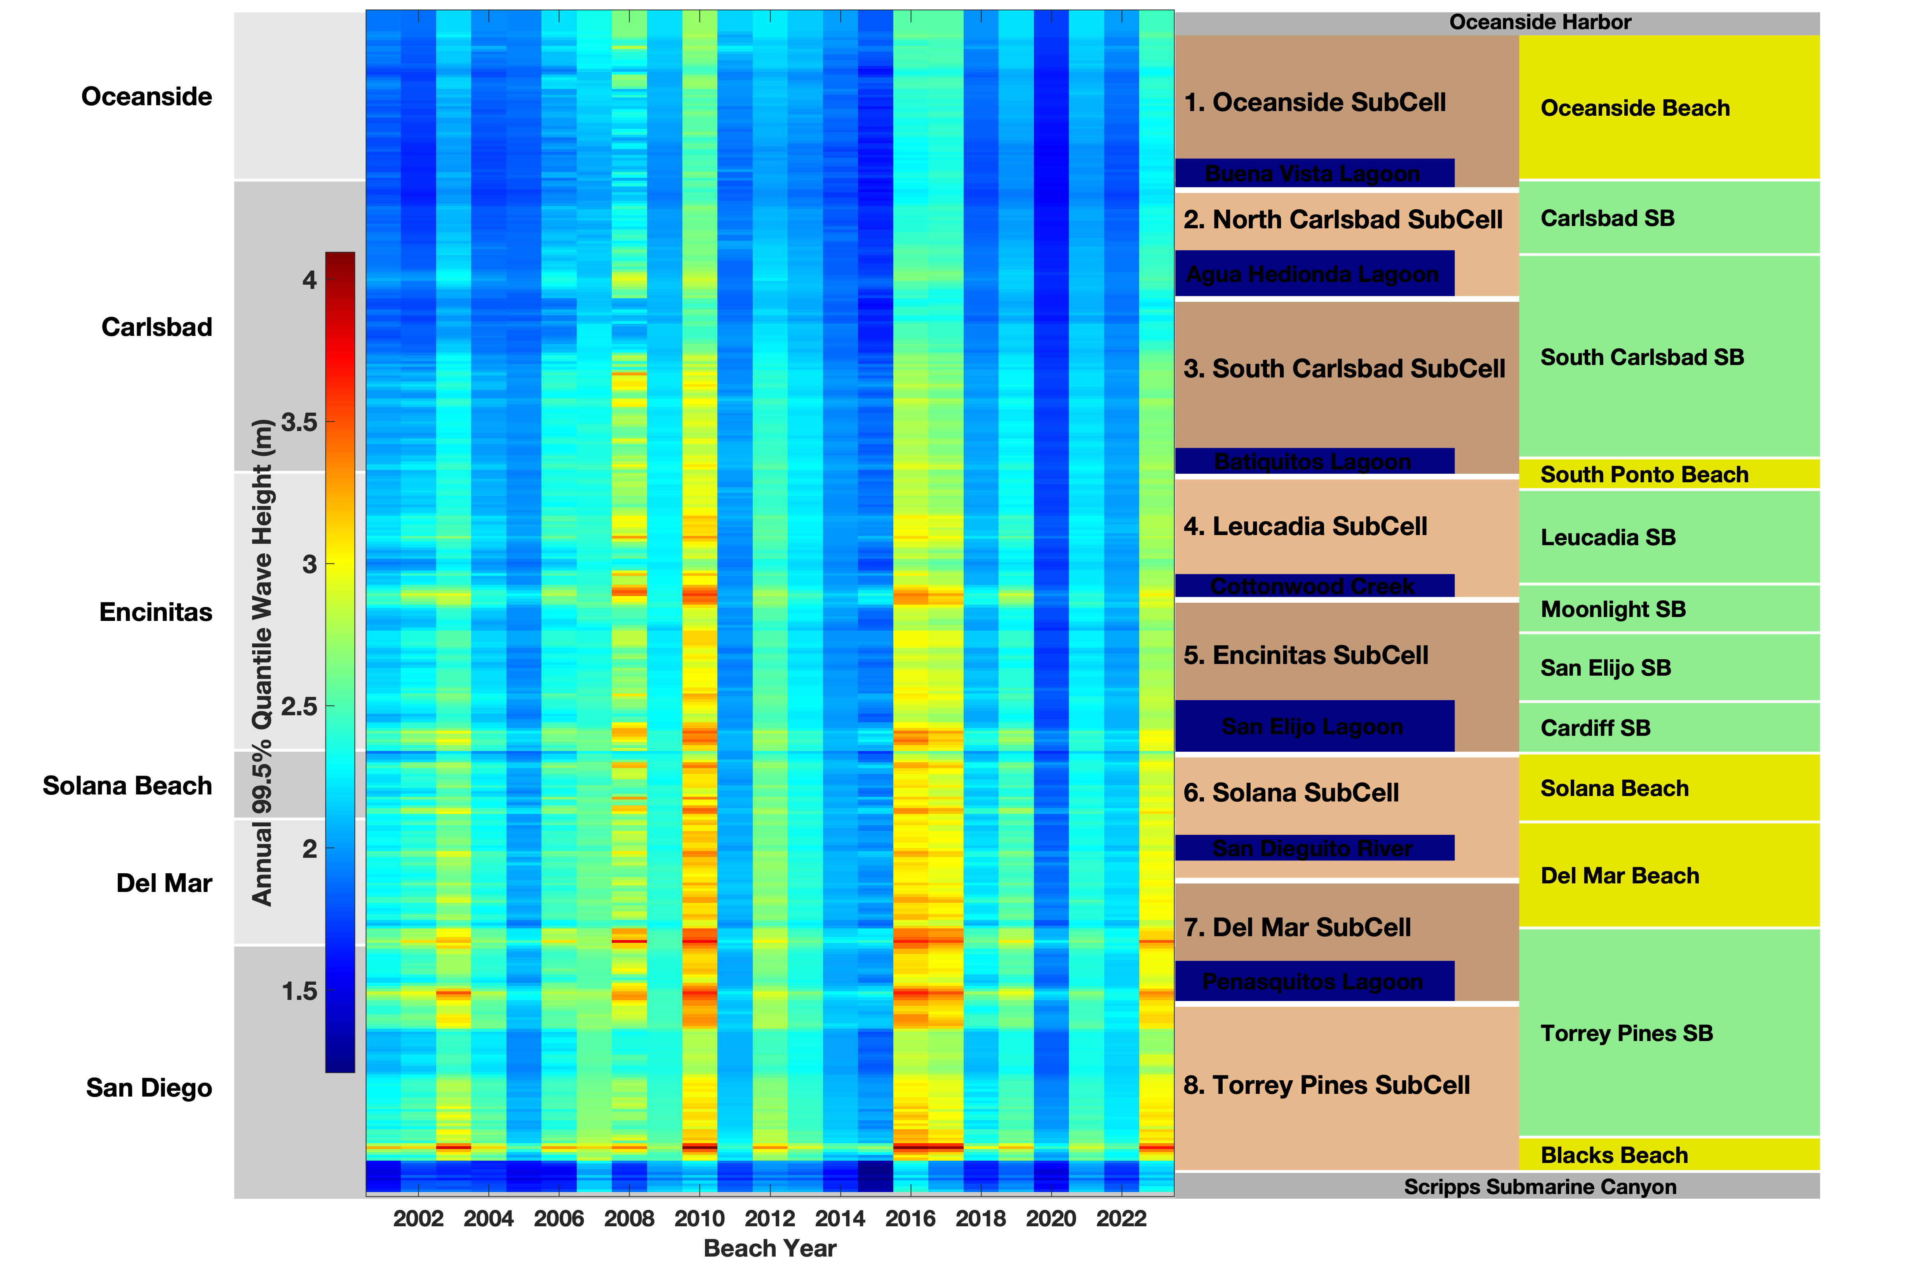
MOP Waves & BEACHES
8 Sub-Cells
Annual Highest
(99.5% Quantile)
Wave Heights
(10m Depth)

Slide 11
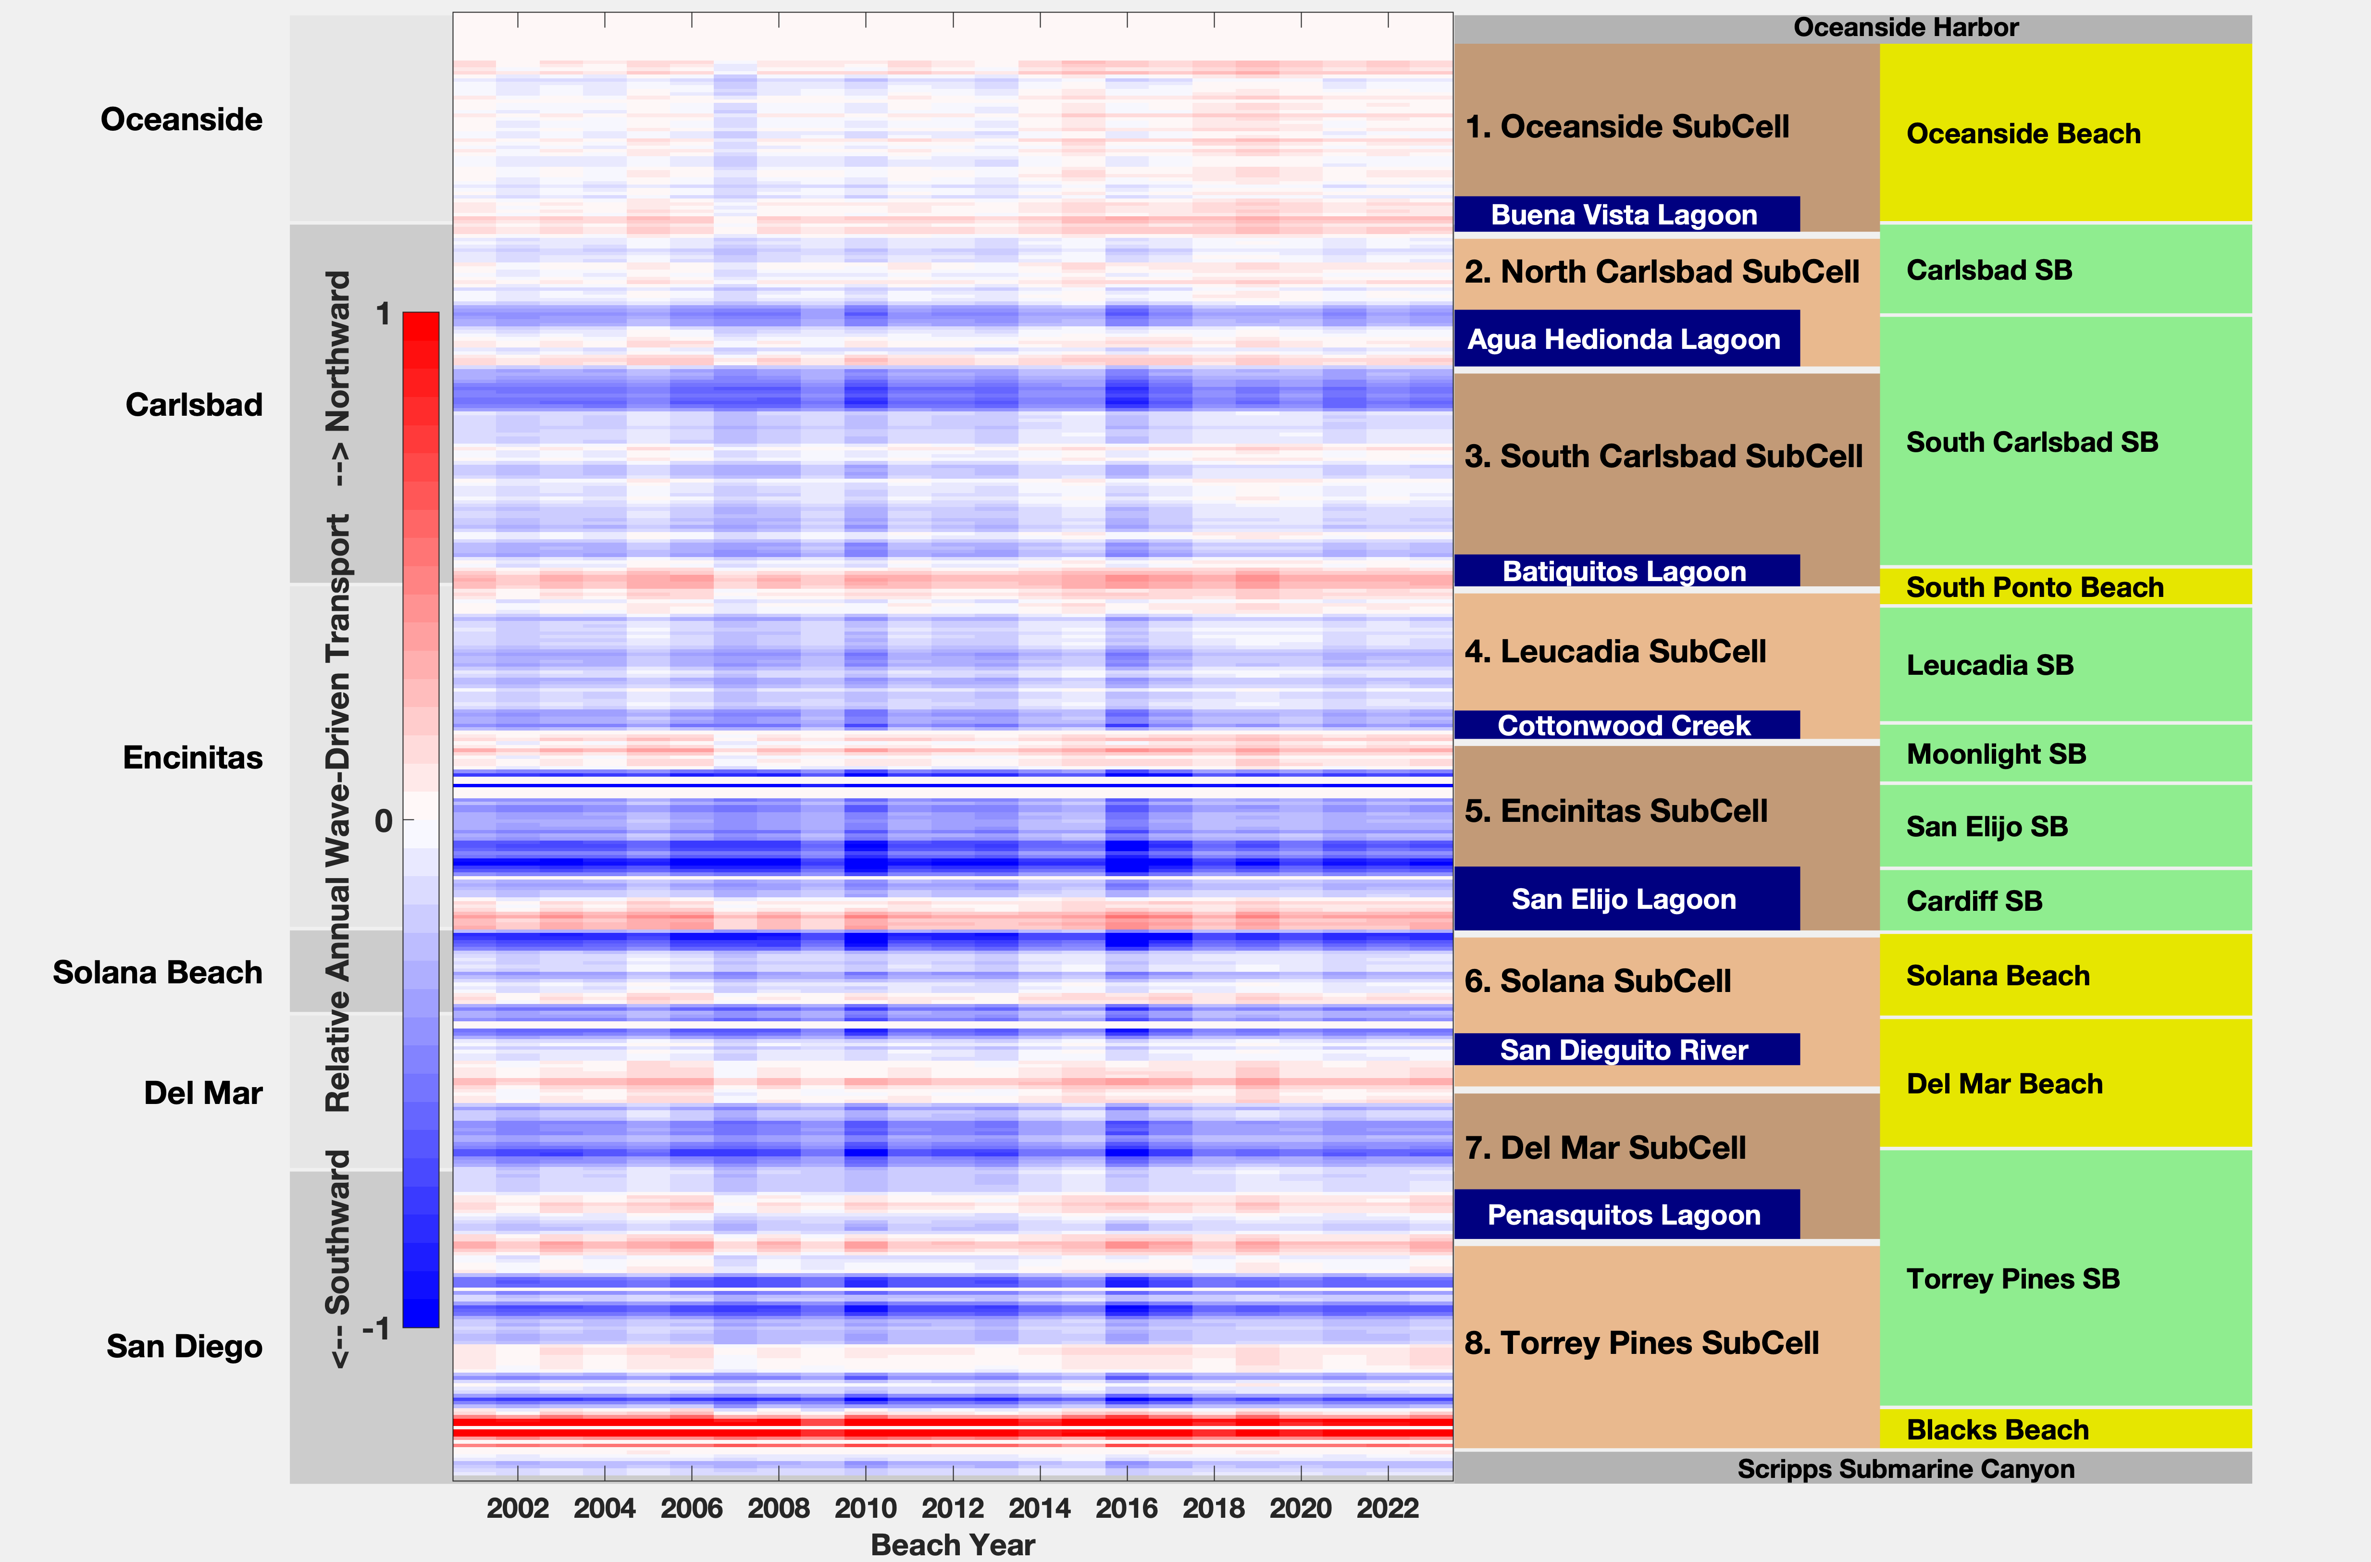
MOP Waves & BEACHES
8 Sub-Cells
Annual Total
Potential
Transport
(10m Depth)

Slide 12
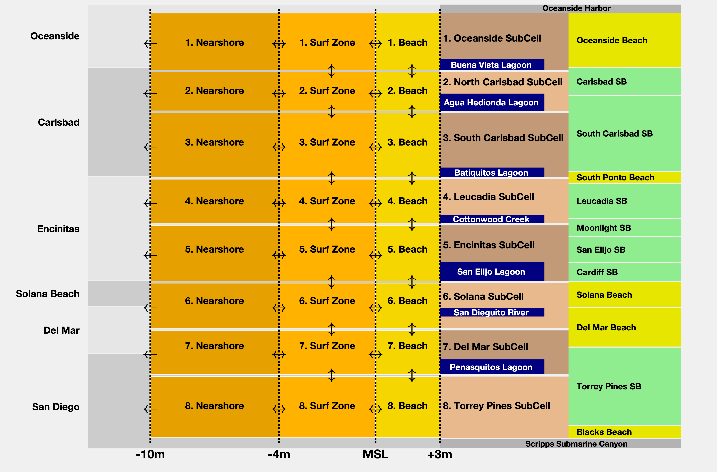
MOP Waves & BEACHES
8 Sub-Cells
x 3 cross-shore zones
=
24 Sand Budget
Compartments

Slide 13
ONGOING RESEARCH:
The NEARSHORE River OF SAND

Slide 14
ONGOING RESEARCH:
The NEARSHORE River OF SAND

Slide 15
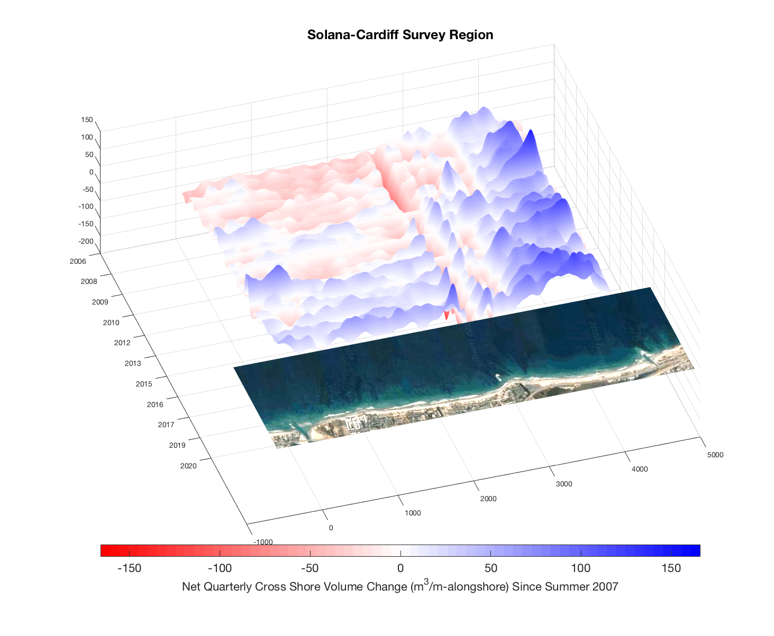
ONGOING RESEARCH:
The NEARSHORE River OF SAND
Observed Southward Sand
Transport Between Sub-Cells
2007-
Mostly
Sand Volume
Retention
Some Littoral
Transport
REEF
2019-
REEF
Year
Cardiff SB
San Elijo Inlet
Sand Channel
Encinitas Sub-Cell
Solana Beach
San Dieguito
Inlet
Solana Sub-Cell
Alongshore Distance (m)

Slide 16
COASTAL LAGOON LITTORAL SUB-CELLS
Coastal Lagoon
SANDY
Land
Sub-Cell Boundary
Ocean
Cliff
Increasing Longshore Transport
Beach Width Loss
ROCKY
20m depth contour
Cliff Erosion Adds Sand
Relic Sediment Fan
“Wave Refraction Lens”
Decreasing Longshore Transport
and bypassing/river input
Beach Width Gain
Coastal Lagoon
Wave Focusing
Erosion Hot Spot south end of lagoon
SANDY
Land
Ocean
Sub-Cell Boundary
Transport Between Sub-Cells
and Permanent Offshore Deposition
Mostly During Severe Winters
ROCKY
Cliff

